Slide 1
CMSC201 Computer Science I for Majors Lecture 0X – Careers
Prof. Katherine Gibson

Slide 2
Today’s Objectives
To introduce careers in Computer Science
To explore using Computer Science with other fields (interdisciplinary)
To better understand Computer Science job listings and descriptions
To discuss grad degrees in Computer Science

Slide 3
Careers in STEM Fields

Slide 4
What is STEM?
STEM is an acronym referring to the academic disciplines of:
Science,
Technology,
Engineering, and
Mathematics

Slide 5
STEM Job Market (2013)
5.7 million total postings in STEM fields
4.4 million (76%) require at least a bachelor’s degree
2.3 million (41%) are entry-level jobs
Requiring less than 2 years of experience
http://burning-glass.com/research/stem/

Slide 6
STEM Jobs by Career Area
http://burning-glass.com/research/stem/

Slide 7
Entry-Level STEM Jobs by Career Area
http://burning-glass.com/research/stem/

Slide 8
Demand for STEM Graduates
48% of all entry-level jobs requiring a bachelor’s degree or higher are in STEM fields
Only 29% of bachelor’s degrees are in a STEM field
There are 2.5 entry-level job postings for each new 4-year graduate in STEM fields
Compared to 1.1 postings for each new graduate in non-STEM fields
http://burning-glass.com/research/stem/

Slide 9
Introduction to Careers in Computer Science

Slide 10
http://www.rasmussen.edu/degrees/technology/blog/what-can-you-do-with-computer-science-degree/

Slide 11
Software Applications Developer
Daily duties:
Design or customize computer applications software
Modify existing software to optimize operational efficiency or correct errors
Evaluate software requirements and user needs to determine software feasibility
Available jobs (7/2014 – 6/2015): 165,063
Projected growth (2012-2022): 22 percent or higher
Median annual salary (2014): $95,510

Slide 12
Interdisciplinary Computer Science

Slide 13
Learning to Program is for Everyone
In the Lost Interview with Steve Jobs, he said:
“I think everybody in this country should learn how to program a computer because it teaches you how to think.”

Slide 14
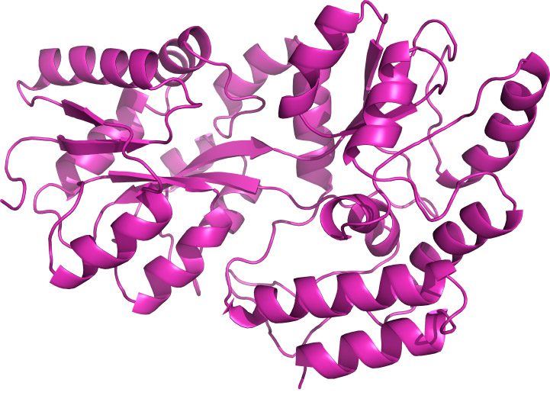
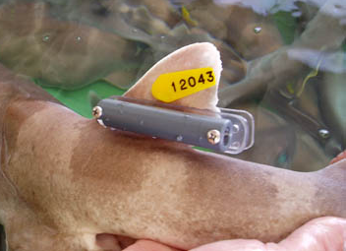
Computer Science and Biology
Human Genome Project
Tagging and tracking animals
Protein folding

Slide 15
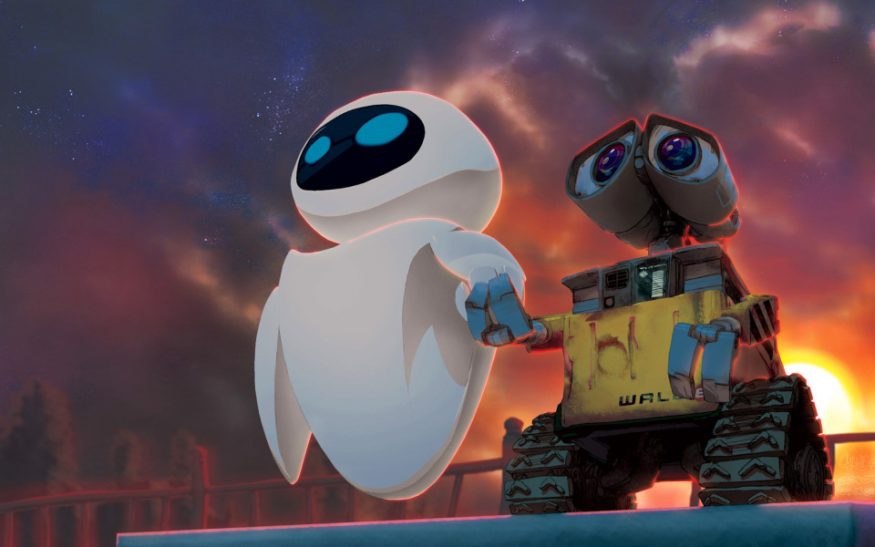
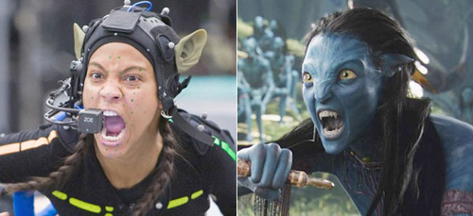
Computer Science and Film
Animated films
Motion capture
CG special effects

Slide 16
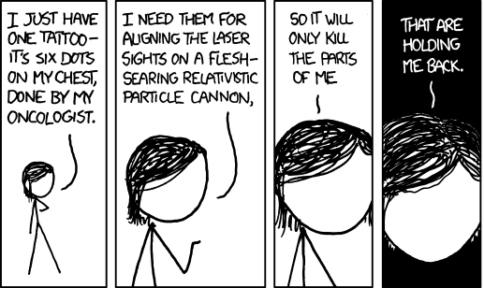
Computer Science and Healthcare
Pharmaceutical manufacturing
Predictive diagnostics
Chemotherapy machines

Slide 17
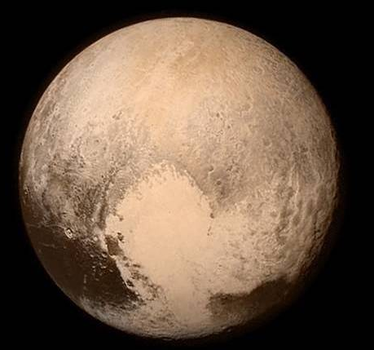
Computer Science and Space
Analyzing data from spacecraft
Planning the Mars mission
Programming landers, shuttles, etc.
Margaret Hamilton & her Apollo 11 code

Slide 18
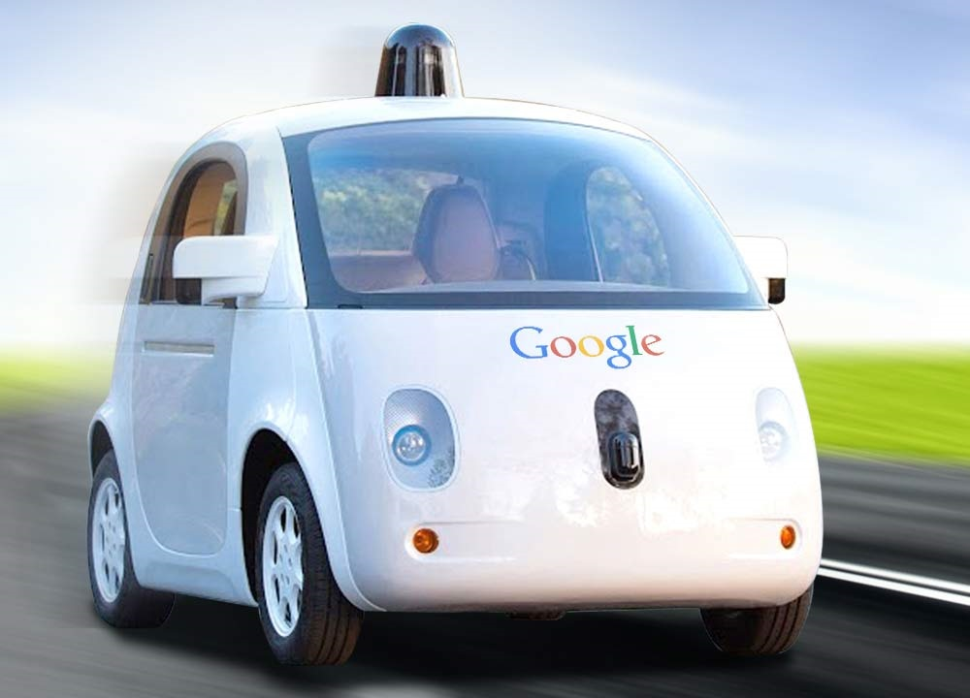
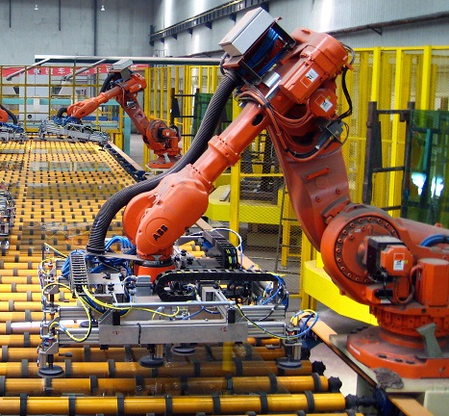
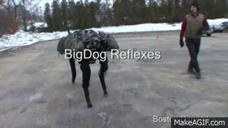
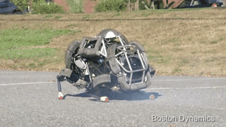
Computer Science and MechE
Google’s self-driving car
Automated factories
Robots!
Robot bloopers:
https://www.youtube.com/watch?v=g0TaYhjpOfo

Slide 19
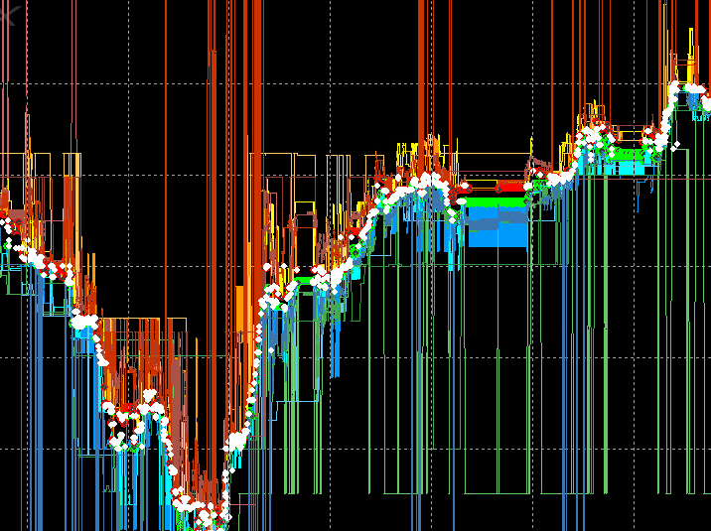
Computer Science and Finance
High-frequency trading
Computational finance
Risk analysis

Slide 20
Job Listings and Descriptions

Slide 21
Job Descriptions
Generally made up of the following:
Company Description
General Job Description
Required Skills
Minimum education
Minimum years of experience
Desired Skills
Other comments

Slide 22
Example Job Listing
Application Developer (Entry Level)
Required Skills:
B.S. degree or higher in Computer Science, Computer Engineering, or Electrical Engineering.
Programming skills in PHP
Experience in development of web applications
Experience in SQL
Experience with the software development lifecycle to include requirements definition and unit testing
http://www.telecomcareers.net/JobSeekerX/ViewJobEx.asp?back=y&JobID=2OX0JJ5ZQv1o4tpCeekJqG4VwzDb5w

Slide 23
Example Job Listing
???
Application Developer (Entry Level)
Job Requirements:
Bachelors Degree in Computer Science, Engineering or a related technical discipline, or the equivalent combination of education, technical training, or work/military experience.
2-5 years of related software development experience.
Must have a minimum of a Secret security clearance; TS/SCI is preferred
http://www.telecomcareers.net/JobSeekerX/ViewJobEx.asp?back=y&JobID=2OX0JJ5ZQv1o4tpCeekJqG4VwzDb5w

Slide 24
Grad School (Master’s and Ph.D.)

Slide 25
Why (or Why Not) Grad School?
Reflect – think about your education so far
What are your passions?
What are your goals in life?
What excites you?
What lifestyles might you want?
Avoid listening to what others tell you to do; think about what you want
http://web.cs.dartmouth.edu/undergraduate/major-redesign/advice-for-majors

Slide 26
Why (or Why Not) Grad School?
An MS is basically a technical degree that gives you more interesting job opportunities
A PhD is basically a research degree, which opens up a host of advanced and research-oriented opportunities
In industry, MS and PhDs are often a ticket to eventual upper-level management
http://web.cs.dartmouth.edu/undergraduate/major-redesign/advice-for-majors

Slide 27
How Long is Grad School?
MS
1 to 2 years is typical
PhD
4 to 6 years is typical
It can take longer! (8 years or more)
Many schools have a limit to how long you can take
http://web.cs.dartmouth.edu/undergraduate/major-redesign/advice-for-majors

Slide 28
What Is It Good For?
MS is essentially a technical degree
Open up a range of much more interesting jobs
More responsibility, creativity, flexibility, and income
PhD is basically a research degree
Research today is collaborative (interdisciplinary!)
No “lonely hacker toiling away alone in the night”
Many become professors and also teach classes
http://web.cs.dartmouth.edu/undergraduate/major-redesign/advice-for-majors

Slide 29
Paying for Grad School
MS
Vast majority require you pay tuition and fees
Companies may pay for their employees to get an MS, either part-time or with a year off to go to school
PhD
For most STEM fields (including CS), the school pays you to get your degree, as long as you’re full-time
Tuition, fees, and normally a (small) stipend
http://web.cs.dartmouth.edu/undergraduate/major-redesign/advice-for-majors

Slide 30
Applying to Grad School
Start early!
Fall of senior year, or even the summer before that
Write to departments and request informational brochures and application materials
Ask professors who know you well for reference letters
Take the GRE in October (or December), and have the scores forwarded directly to the schools you applied to
Send in your application well before the deadline
Follow up on everything! (Be paranoid about the mail)
http://web.cs.dartmouth.edu/undergraduate/major-redesign/advice-for-majors

Slide 31
Announcements
No Lab this week (November 23rd to 26th)
No office hours after Wednesday at 2:30pm
Lab 12 will be held next week – our last lab! ☹
Project 2 has been posted
Due on Tuesday, December 8th at 8:59pm
Next Class: Algorithms and Analysis

Slide 32
Have a Happy Thanksgiving!

Slide 33
Announcements
Your Lab 2 is an online lab again this week!
Due by this Friday (Sept 11th) at 8:59:59 PM
Homework 1 is out
Due by TONIGHT (Sept 8th) at 8:59:59 PM
Homework 2 is out later today
Both of these assignments are on Blackboard
Weekly Agendas are also on Blackboard

